Slide 1
Hermes: UAV + AI for post disaster damage assessment
Sub- Initiative of Global Emergency Management Solutions
GEMS-AI

Slide 2
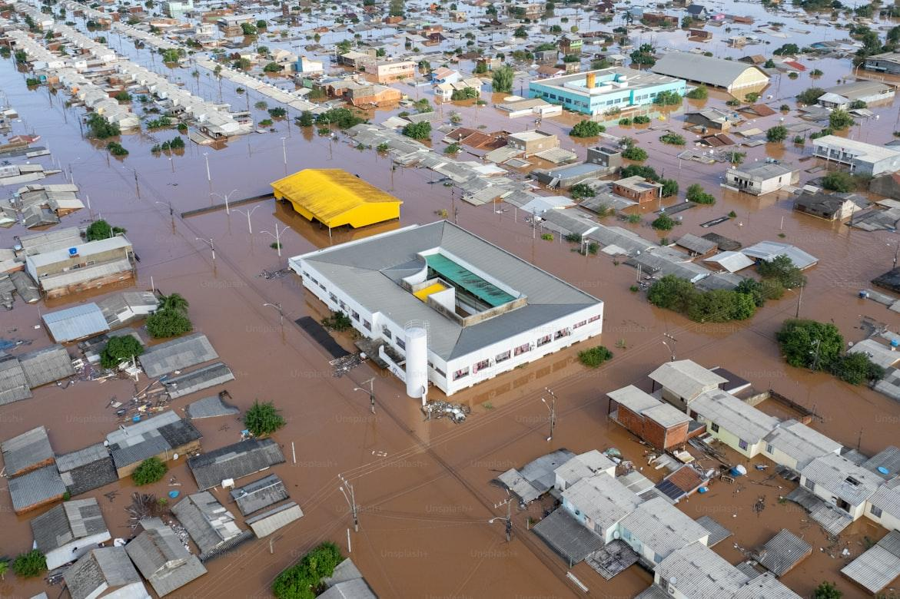
Problem
Extreme weather events are increasing in frequency and severity
Currently FEMA Preliminary Damage Assessment (PDA) process is time-intensive, subjective and requires in person validation
Limited situational awareness delays funding and slows recover
First responders lack adequate tools to implement timely and effective disaster logistics

Slide 3
Opportunity
UAVs provide rapid, flexible aerial coverage
Mobile application in disasters zones with finer grain imagery that satellite and high-altitude flights
Hermes bridges FEMA requirements with academic UAV/AI research
AL/ ML can automate:
Structural damage classification
Flood extent detection
Object recognition in complex environment

Slide 4
FEMA PDA Alignment
FEMA PDA Guide requires accurate, standardized, and validated damage data
Hermes delivers:
Rapid Imagery Capture(drones in <24 hr)
AI-driven categorization aligned with FEMA’s IA/PA metrics
GIS-ready outputs for integration into FEMA’s Field Assessment Collection Tool

Slide 5
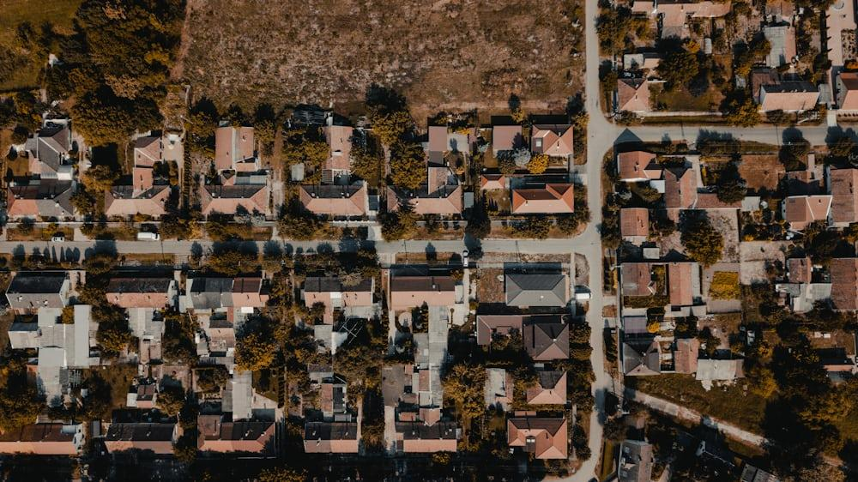
Core Technology
Hermes AI Stack:
Multi-task semantic segmentation (FloodNet + RescueNet)
Object Detect using enhanced YO (CF-YOLO for small targets)
Change detection using xBD dataset
Meta-learning for adaptive UAV control under uncertain conditions

Slide 6
Data Sources
FloodNet & RescueNet
xBD Dataset – 850k annotated building across multiple disasters
DOTA Dataset – 1.8 M object annotation
NOAA Aerial imagery

Slide 7
Hermes Model Pipeline
UAV imagery acquisition
Simultaneous semantic segmentation of flood zones & damage levels (pixel-wise)
Post-processing bounding boxes around damaged buildings
Damage classification; FEMA Joint Damage Scale (No Damage, minor damage, major damage, destroyed)
GIS export, PDA-ready reporting, statistical analysis & heatmap generation

Slide 8
Prototype Results (Hermes v0.2)
Trained DeepLabV3 multi-task model on FloodNet & RescueNet
Successful binary segmentation of flood vs non-flood regions
Damage classification achieved in controlled dataset test
CF-Yolo promising for detecting small targets in drone imagery

Slide 9
Prototype Results (Hermes v0.3)
Upgraded to DeepLabv3-ResNet101 backbone (vs ResNet50 in v0.2)
Added channel & spatial attention mechanism for feature refinement
Implemented cross-task feature fusion between flood/damage branches
Mixed precision training enabling 4x larger batch sizes (32 v 8)
Training Speed: 3-4x faster per epoch with AMP on A100
Memory Efficiency: Gradient accumulation allows effective batch size of 128

Slide 10
Proposed Hermes(v0.4 – post-processing)
Bounding boxes with damage severity colors
Flood overlap percentage per building
Confidence scores for each detection
Spatial damage distribution (heatmap)
Actionable quantified data, building count, severity counts, localities and percentiles
Composite view for comprehensive reports
Export to JSON, PDF, Power Bi, Tableau,
Real time API integration

Slide 11
Differentiators
FEMA-Compliance focus
Bandwidth-efficient semantic extractor for UAV-ground comms
Modular SaaS platform

Slide 12
Market & Clients
FEMA + State Emergency Management Agencies
Insurance companies(faster claims processing).
Municipal governments (pre and post disaster planning)
International HADR (Humanitarian Assistance & Disaster Response)

Slide 13
Business Model
Contracted UAV damage mapping services (subcontractor)
SaaS subscription for Hermes AI dashboard
Data licensing to insurers & governments agencies

Slide 14
Next company steps
Pilot project with Florida municipalities(2025 Hurricane Season)
Obtain VOSB, SDVOSB, apply for Apex Accel
Secure subcontracting role under FEMA PA-TAC
Build Hermes SaaS dashboard (Cloud-based GIS integration + PDA –ready reports)

Slide 15
Fundamental Research
Core UAV + AI Damage Assessment
1. Damage Assessment after Natural Disasters with UAVs: Semantic Feature Extraction using Deep Learning: Proposes onboard semantic extractors to reduce bandwidth and still maintain high accuracy in disaster damage classification (FloodNet, RescueNet datasets).
Key for Hermes = bandwidth-efficient UAV comms.
2. UAVs in Disaster Management: Application of Integrated Aerial Imagery and Convolutional Neural Network for Flood Detection:
Uses CNNs with UAV imagery to detect floods (Pakistan case study).
Achieved 91% flood detection accuracy.
Key for Hermes = flood-specific model integration.

Slide 16
Fundamental Research
Advanced Object Detection
5. CF-YOLO for Small Target Detection in Drone Imagery based on YOLOv11 Algorithm:
Tailors YOLOv11 for drone imagery where 60–80% of objects are <32×32 pixels.
Introduces CS-FPN (cross-scale feature pyramid) + LSDECD detection head.
Key for Hermes = improving UAV detection of small/dense disaster objects.
Control and Autonomy
6. Meta-Learning for Adaptive Control with Automated Mirror Descent (Tang, Sun, Azizan, MIT)
Combines meta-learning with adaptive control for UAVs under uncertain disturbances (e.g., strong winds in disaster zones).
Key for Hermes = robust UAV flight autonomy in unstable post-disaster environments.

